Slide 1
ABOUT AUSTRALIA BOND UNIVERSITY BUSINESS DEGREES
BACHELORS AND MASTERS

Slide 2
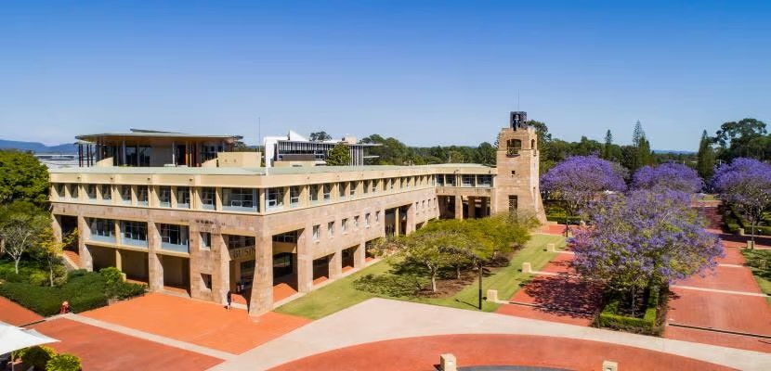
Bond business school
Ranks in the top 2% of business schools in the world.
AACSB and EQUIS accredited.
The #1 job title held by Bond Business School alumni is director, closely followed by managing director, manager and CEO.
Include in the top 10 employers of Bond graduates are KPMG, PwC, Ernst & Young, Deloitte and the big four banks.
Accelerating academic calendar with three semesters a year.
CRICOS Provider Code: 00017B TEQSA: PRV12072

Slide 3
Bond’s Bachelor of Commerce degree
https://bond.edu.au/program/bachelor-of-commerce
Bachelor of Commerce (CRICOS code: 063059D) include five key majors:
Accounting
Actuarial Science
Data Analytics
Economics
Finance
CRICOS Provider Code: 00017B TEQSA: PRV12072

Slide 4
Bond’s Bachelor of BUSINESS degree
https://bond.edu.au/program/bachelor-of-business
Bachelor of Business (CRICOS code: 063055G) include six key majors:
Entrepreneurship and Innovation
International Business
Marketing Communication
Management
Marketing
Tourism and Hotel Management.
CRICOS Provider Code: 00017B TEQSA: PRV12072

Slide 5
Ccu – bond pathways
UG pathway – students study the first two years at CCU, Bond will grant maximum 80cp blanket credits which allows CCU students to study four or five semesters at Bond depends on which intake (Jan, May or September).
PG pathway – student study the first year at CCU, Bond will grant 40cp blanket credit which allows CCU students to study three semesters (1 year) at Bond. Alternatively students can also be assessed additional 20cp foundation program credits on a case by case basis which equals to maximum 60cp and students only need to study two semesters (8 months) at Bond.
CRICOS Provider Code: 00017B TEQSA: PRV12072

Slide 6
Undergraduate STUDY PLAN
Bachelor of Commerce (CRICOS code: 063059D) – Commencing September
Semester | Subject 1 | Subject 2 | Subject 3 | Subject 4
September | ACCT11-100 Accounting Principals | ECON11-100 Principles of Economics | STAT11-112 Quantitative Methods | CORE11-012 Responsibility, Integrity and Civic Discourse
January | ECON12-200 Linear Models and Applied Econometrics | FINC11-101 Fundamentals of Finance | LAWS10-100 Business Law This unit code may be changing. Faculty to confirm | Major Subject Chosen subject from Major
May | ACCT11-102 Management Accounting | Major Subject Chosen subject from Major | FINC12-201 Financial Applications and Analysis | BUSN12-200 Responsible and Sustainable Organizations
September | Major Subject Chosen subject from Major | Major Subject Chosen subject from Major | Major Subject Chosen subject from Major | Major Subject Chosen subject from Major
CRICOS Provider Code: 00017B TEQSA: PRV12072

Slide 7
Undergraduate STUDY PLAN
Bachelor of Business (CRICOS code: 063055G) – Commencing September
Semester | Subject 1 | Subject 2 | Subject 3 | Subject 4
September | ACCT11-100 Accounting Principals | CORE11-012 Responsibility, Integrity and Civic Discourse | ECON11-100 Principles of Economics | MKTG11-100 Marketing Fundamentals
January | LAWS10-210 Enterprise Law | Statistics Option Students must choose ten credit points (10cp) of the statistics option subjects | Major Subject Chosen subject from Major | Major Subject Chosen subject from Major
May | BUSN13-331 Business Model Generation | FINC11-101 Fundamentals of Finance | Major Subject Chosen subject from Major | Major Subject Chosen subject from Major
September | BUSN13-332 Business Model Execution | MGMT13-305 Human Resource Management | Major Subject Chosen subject from Major | Major Subject Chosen subject from Major
CRICOS Provider Code: 00017B TEQSA: PRV12072

Slide 8
POSTGRADUATE STUDY PLAN
Master of Business (CRICOS code: 063119G) – Commencing September
Semester | Subject 1 | Subject 2 | Subject 3
September | ACCT71-100 Accounting Principles | MKTG71-100 Marketing Fundamentals | MGMT71-301 International Human Resource Management
January | ECON71-100 Principles of Economics | FINC71-101 Fundamentals of Finance | STAT71-111 Business Statistics
May | MGMT71-104 Managing People | MGMT71-311 Leading Innovation and Change
CRICOS Provider Code: 00017B TEQSA: PRV12072

Slide 9
English language proficiency requirements
Chinese Culture University students who wish to enrol in Bond University programs must satisfy the English language proficiency requirements mandated by Bond University of enrolment.
Current English language requirements for a Bachelor of Business, Bachelor of Commerce or Master of Business is evidenced by one of the below:
International English Language Testing System (IELTS) Academic Overall score 6.5 with no sub score less than 6.0
Test of English as a Foreign Language Internet-Based Test (TOEFL iBT) Overall score 79 (no scores below 21 in Writing, 18 in Speaking, and 16 in Reading and Listening)
Pearson Test of English (PTE) Academic Overall score 58 with no Communicative Scores below 50
CRICOS Provider Code: 00017B TEQSA: PRV12072

Slide 10
Tuition fee
Tuition fees are listed on Bond University website and are subject to increase each calendar year.
Estimated tuition fees in 2024 are:
Bachelor of Business / Bachelor of Commerce: AUD 22,920 per semester (4 subjects)
Master of Business: AUD 18,380 per semester (3 subjects)
CRICOS Provider Code: 00017B TEQSA: PRV12072

Slide 11
Personalised and multicultural experience
Career Development Centre
Academic Skills Centre
Transformer Program
90+ student clubs and associations
80+ nationalities on campus
Alumni in 130+ countries
CRICOS Provider Code: 00017B TEQSA: PRV12072

